Slide 1
Digital Portfolio
STUDENT NAME: Devadhatshini.B
REGISTER NO AND NMID: 24131131802522002/asanm11324131131802522002
DEPARTMENT: BSC(computer science)
COLLEGE: 113-Vallalar Arts and Science College,Annamalai University

Slide 2
PROJECT TITLE Photography Portfolio

Slide 3


AGENDA
1. Problem Statement
2. Project Overview
3. End Users
4. Tools & Technologies
5. Portfolio Design & Layout
6. Features & Functionality
7. Results & Screenshots
8. Conclusion
3/21/2024 Annual Review

Slide 4

PROBLEM STATEMENTS: A photography portfolio is essential to showcase skills, style, and creativity. It helps photographers present their best work, attract potential clients, and establish a professional identity

Slide 5

PROJECT OVERVIEW: This portfolio presents a collection of photographs that highlight various genres such as portraits, landscapes, weddings, and creative edits. The aim is to provide a visual story to potential clients and agencies.

Slide 6

END USERS: 1. Clients - Individuals seeking professional photography services 2. Agencies - Looking for skilled photographers 3. Social Media Followers - Audience engagement 4. Recruiters - Evaluating photography talent

Slide 7

Tools and Technologies:
1. Camera & Lenses 2. Adobe Photoshop 3. Adobe Lightroom 4. Canva & Other Editing Apps

Slide 8
POTFOLIO DESIGN AND LAYOUT:
Image-heavy design with minimal text
Sections for About Me, Gallery, Testimonials, Contact Info
Clean and professional aesthetic
8

Slide 9
FEATURES AND FUNCTIONALITY: *High-quality gallery showcasing best works About Me section with professional introduction *Testimonials from clients Easy contact information

Slide 10

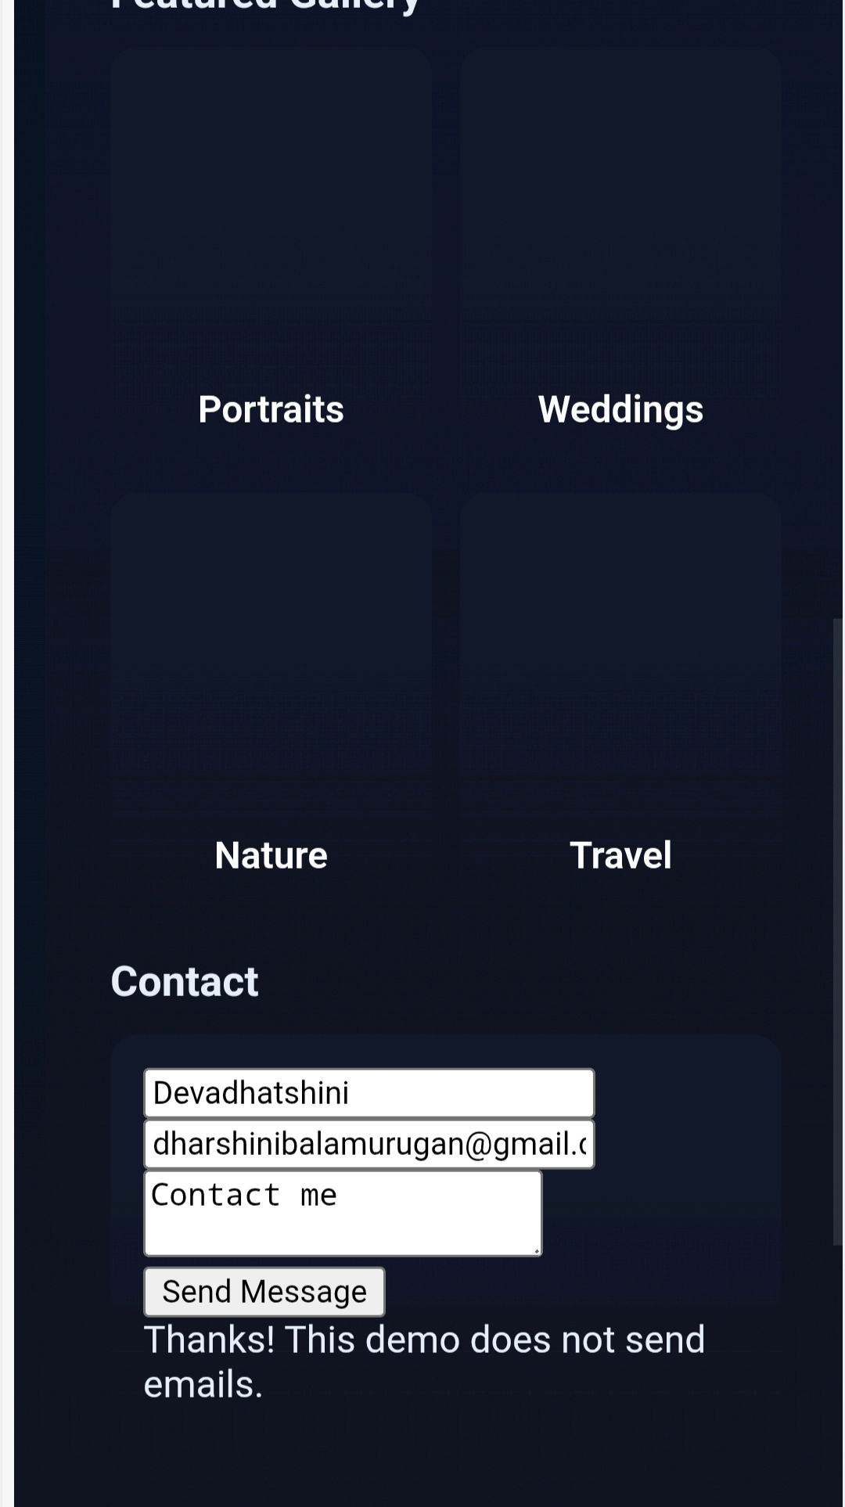
RESULTS AND SCREENSHOTS:
• Successfully created a visually engaging photography portfolio • Demonstrates talent, creativity, and versatility Attracts potential clients and professional opportunities
3/21/2024 Annual Review
10

Slide 11
CONCLUSION
A photography portfolio reflects growth, achievements, and vision. It serves as a tool to showcase strengths, overcome challenges, and highlight future goals as a photographer.
11

